Slide 1

Counterfiet Products Detection Using Blockchain
by
Prashanth Reddy M
Roll No. 204G1A3239
Pravallika U
Roll No. 204G1A3240
Teja Sri G
Roll No. 204G1A3258
Jahnavi S
Roll No. 204G1A3218
Under the guidance of
Dr. P. Chitralingappa _{M. Tech., Ph .D}
Associate Professor
Department of Computer Science and Engineering (Data Science)
Srinivasa Ramanujan Institute of Technology
(Affiliated to JNTUA & Approved by AICTE) (Accredited by NAAC with ‘A’ Grade & Accredited by NBA (EEE, ECE & CSE)
Rotarypuram Village, B K Samudram Mandal, Ananthapuramu – 515701.
2023 - 2024

Slide 2

Contents
Abstract
Problem statement
Objectives of Project
Literature survey for first objective
Literature survey for second objective
Proposed Work -(Methods to be followed for proposed system)
References
GitHub Link
Queries

Slide 3
Abstract
One of the biggest challenges today’s retail market is the counterfeiting of products. Counterfeiting of products are just low-quality copies of some genuine brand. Many different methods have been adopted from time to time to combat the counterfeiting of the products such as artificial intelligence, machine learning and QR code-base system. But these methods have their disadvantages such as QR code can copy from a genuine product to a counterfeit product, artificial intelligence and machine learning need high computational power to do operations. The proposed system improve the detection of counterfeit products with the help of blockchain technology. It will collect the unique code from the customer by scanning the QR code given on the product then the system will check for the code in the database i.e., Ethereum. If the code matches, it will give a receipt of the products to the customers, otherwise it will notify the customer that the product is not legit. The blockchain helps to store the supply chain of products as a blockchain-based system makes a decentralized system and one of the main advantages of blockchain is that if the data is recorded in the system then nobody can change it makes our data more secure and protected from third parties.

Slide 4
Introduction
The global development of a product or technology always comes with risk factors such as counterfeiting and duplication, which can affect the company's name, company revenue, and customer health.
Blockchain is an arrangement of recording information that makes it troublesome or hard to change, hack, or cheat the framework.
A blockchain is essentially a computerized record of transactions that is duplicated and distributed across the entire network of PC systems on the blockchain.
Once the product is stored on the network hash code is generated of that product and it is possible to maintain all transaction records of the product and its current owner as a chain will be created for that product transactions.
In the proposed system we are assigning a generated QR code to a particular product and the end customer can scan that QR code to get all information about that product.

Slide 5
Problem Statement
The worldwide improvement of an item or innovation consistently accompanies hazard factors, for example, forging and duplication.
Counterfeit goods pose a significant threat to industries and consumers, leading to economic losses, brand reputation damage and safety risks.
India and different countries are battling such Counterfeit items. In the proposed framework, the framework produces QR codes utilizing Blockchain innovation.
This innovation stores exchange records in blocks. These squares and secure and difficult to access and change the data from it. By utilizing a QR code we can recognize the counterfeit item.

Slide 6
Objective
To implement the Counterfeit product detection by using ethereum.

Slide 7
Literature Survey
A Survey of Counterfeit Product Detection by Prabhu Shankar, R. Jayavadivel. Counterfeit products are growing exponentially with the enormous amount of online and black-market. This is one of the active research areas to b This paper discusses various techniques for identifying counterfeit products.[1]
Smart Tags for Brand protection and anti-counterfeiting in the wine industry by steven, Marko. This paper describes a brand protection and anticounterfeiting solution for the wine industry based on smart tags and Cloud enabled technologies. The main idea behind smart tags is to utilize quick response codes and functional links supported by the Cloud system and two-way communication between the winemaker and end-user. [2]
A Blockchain-based Supply Chain Quality Management Framework by Si Chen, Rui Shi. In this paper, we propose a blockchain-based framework. This framework will provide a theoretical basis for intelligent quality management of the supply chain based on blockchain technology.[3]

Slide 8
Proposed System
To protect brand value and duplication threats by developing fake product detection system using blockchain technology.
To secure and authenticate the product details which helps in identification and traceability of the specific product throughout the supply chain.
All product details are secured and stored in QR code or product ID which helps in identification which is stored in tamper proof blocks of blockchain for further security.
Manufacturer can add product details and system generates QR code which can be used by retailers and distributors for tracing and even by consumers to ensure purchasing of original products.

Slide 9
Reference
[1].Si Chen, Rui Shi, Ren, Jiaqi Yan, Yani Shi, “A Blockchain-based Supply Chain Quality Management Framework”, 14th, IEEE International Conference on e-Business Engineering, 2017.
[2].Blockchain Based Fake Product Identification in Supply Chain www.irjet.net: Ajay Funde, Pranjal Nahar, Ashwini Khilari.
[3].Fake News Detection In Social Media using Blockchain: - Shovon Paul, Jubair Joy, Shaila Sarkar. [4] A Blockchain-Based Application System for Product Anti-Counterfeiting (IEEE Access): Jinhua Ma, Xin Chen, hung-Min Sun.

Slide 10
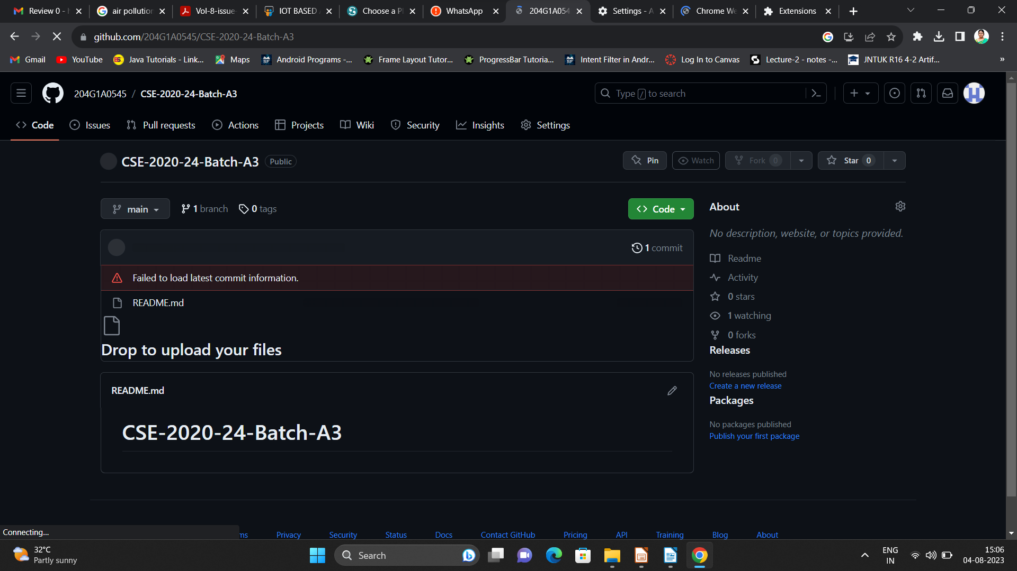

Git Hub Dashboards of each student
Repository Name Like: CSD 2023 – 24 Batch: A – XX
Under that project data upload literature survey papers, and son on..

Slide 11
Any Queries?

Slide 12
Thank You!!!

